Slide 1
Capabilities Approach of Sen and Nussbaum
William Frey
ADEM

Slide 2
Capabilities Approach
“help answer the question, “What is this person able to do or be?”
“Substantial freedoms, causally interrelated opportunities to choose and act.”
“They are not just abilities residing inside a person but also freedoms or opportunities created by a combination of personal abilities and the political, social, and economic environment.”
Paradigm Shift
Replace view that these communities are deficient (have needs…) with view that communities are repositories of capabilities and resources that can be engaged.
Martha Nussbaum. Creating Capabilities: The Human Development Approach. Belknap Press of Harvard University Press, 2011, 20, 33-34.

Slide 3
Conversion Factors
Importance of realizing capabilities
Making real the human potentials of individuals is an essential part of happiness and wellbeing
In language of Capabilities Approach, this is turning capabilities into “functionings”
Means that realize capabilities are called conversion factors: private, social, environmental

Slide 4
More on conversion factors
Personal
Metabolism, physical condition, sex, reading skills, gender, race, caste
Social
Public policies, social norms, practices that unfairly discriminate, societal hierarchies, power relations related to class or gender, race, caste.
Environmental
Physical or built environment, climate, pollution, proneness to earthquakes, presence or absence of seas or oceans
Robeyns, Ingrid, "The Capability Approach", The Stanford Encyclopedia of Philosophy (Summer 2011 Edition), Edward N. Zalta (ed.), URL = <http://plato.stanford.edu/archives/sum2011/entries/capability-approach/>.

Slide 5
Create the background conditions where people are “empowered” to exercise their basic capabilities
Life Bodily Health Bodily Integrity | Sense, Imagination, Thought Emotion Practical Reason |  | Affiliation Other Species
Play |  | Control over one’s environment

Slide 6
Application
Duchity Haiti

Slide 7
Concept | Description | Question posed from concept relative to development | Information from survey and visits relative to concept | Information challenges: focus for more info-gathering activities
Capabilities Approach | “[S]ubstantial freedoms, a set of (causally) interrelated opportunities to choose and act. [These] are not just abilities residing inside a person but also freedoms or opportunities created by a combination of personal abilities and the political, social, and economic environment.” (Nussbaum) | What are the pertinent capabilities affected by electricity availability and use? Can electricity play the role of a conversion factor here? Practical Reasoning: means of realizing life plans and aspirations Affiliations: (economic and social) Control over environment: (unemployment and environmental degradation) | Survey data also indicates that predominant occupations are business/merchant and farming. It also establishes a strong interest in the availability of electricity for carrying out business/market and agricultural activities. It indicates a low level of interesting in using electricity to run entertainment devices like TVs, computers, and radios | More data required both on how electricity would be used and how electricity stands in relation to other energy generation alternatives. One interesting problem. Could computers based on the OLPC model play a greater, and positive role in education. Electricity, thus, could serve as a conversion factor in realizing educational capabilities such as emotion and sensation, imagination, and thought.

Slide 8
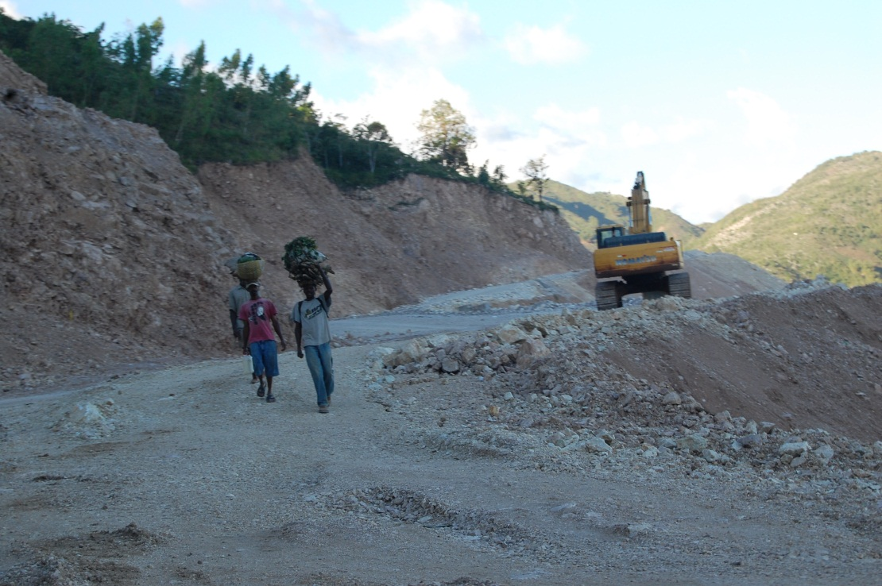
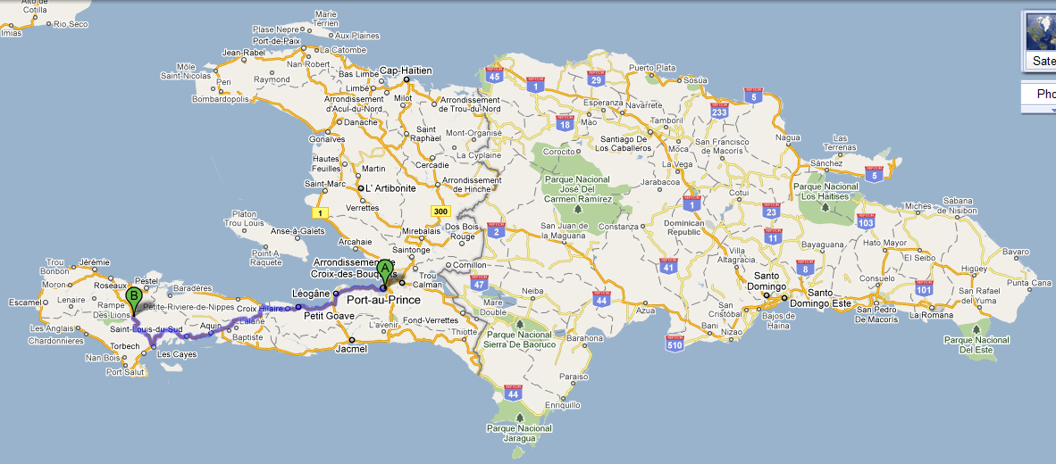
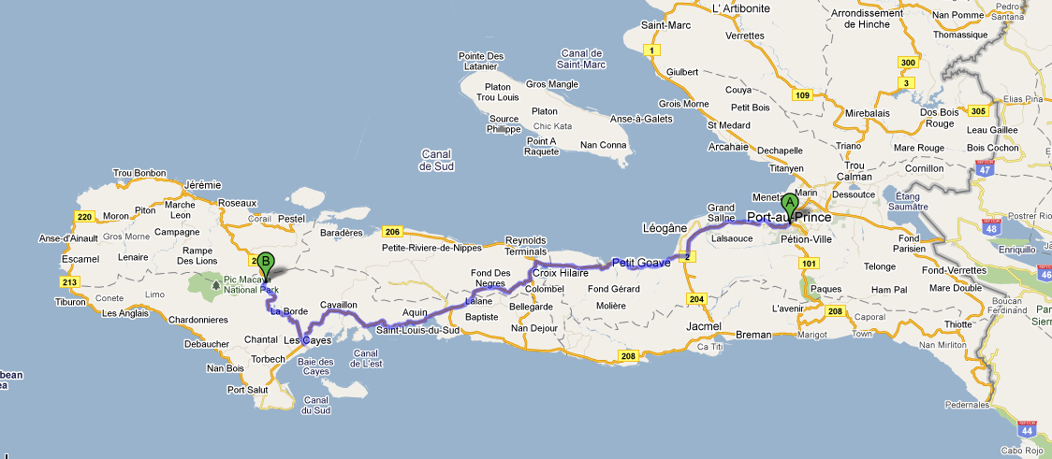
Duchity
220 km, 6-12 hours
Notes:
2011-03-14 #217

Slide 9
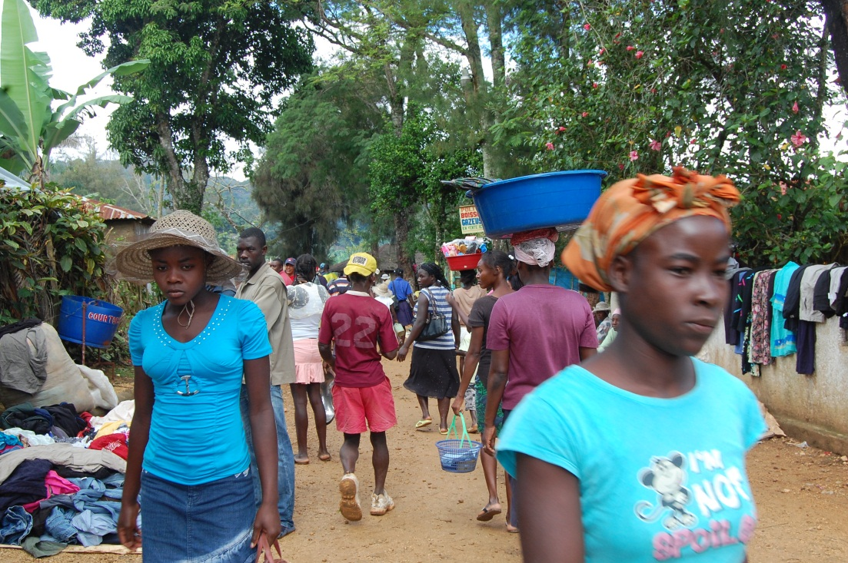
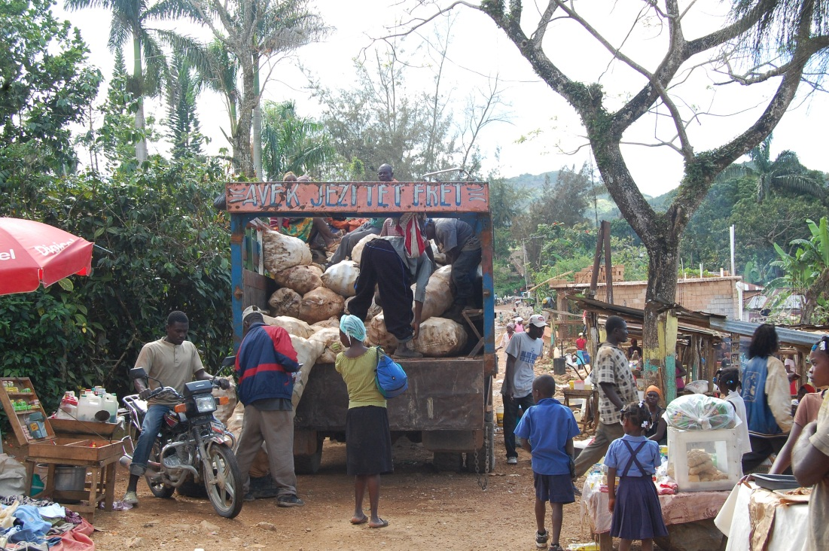
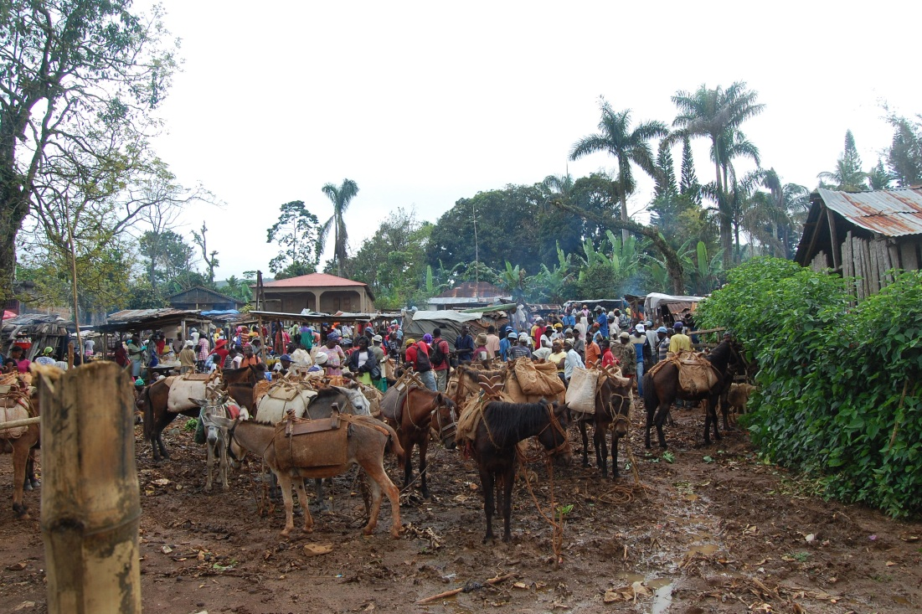
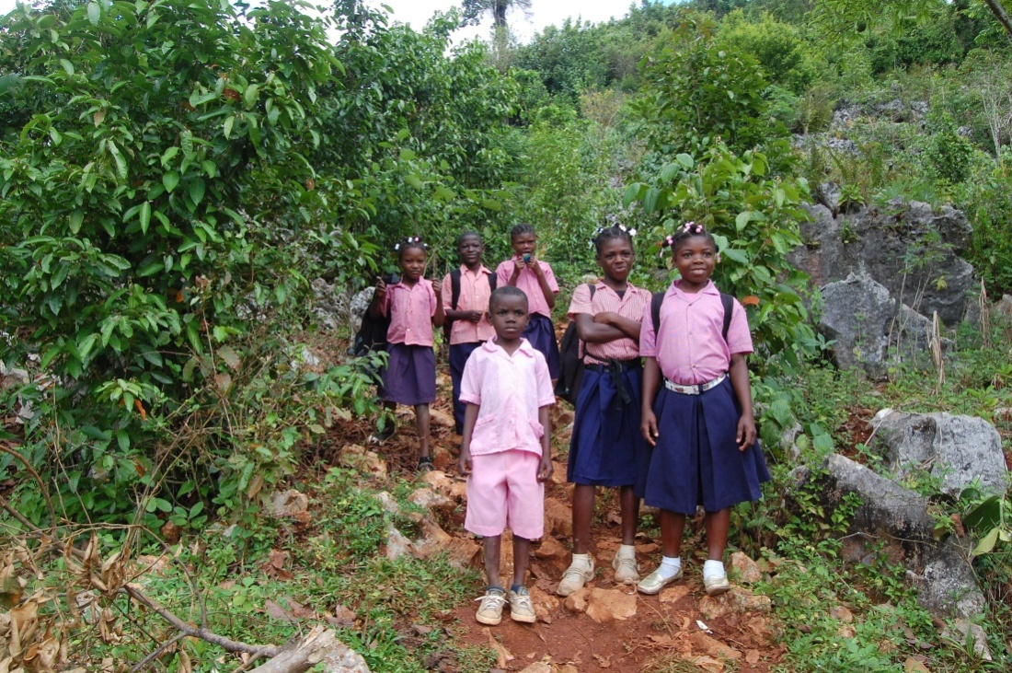
Scenes From Duchity
Notes:
2011-03-14 #260 #304
2011-03-15 #390, #425

Slide 10
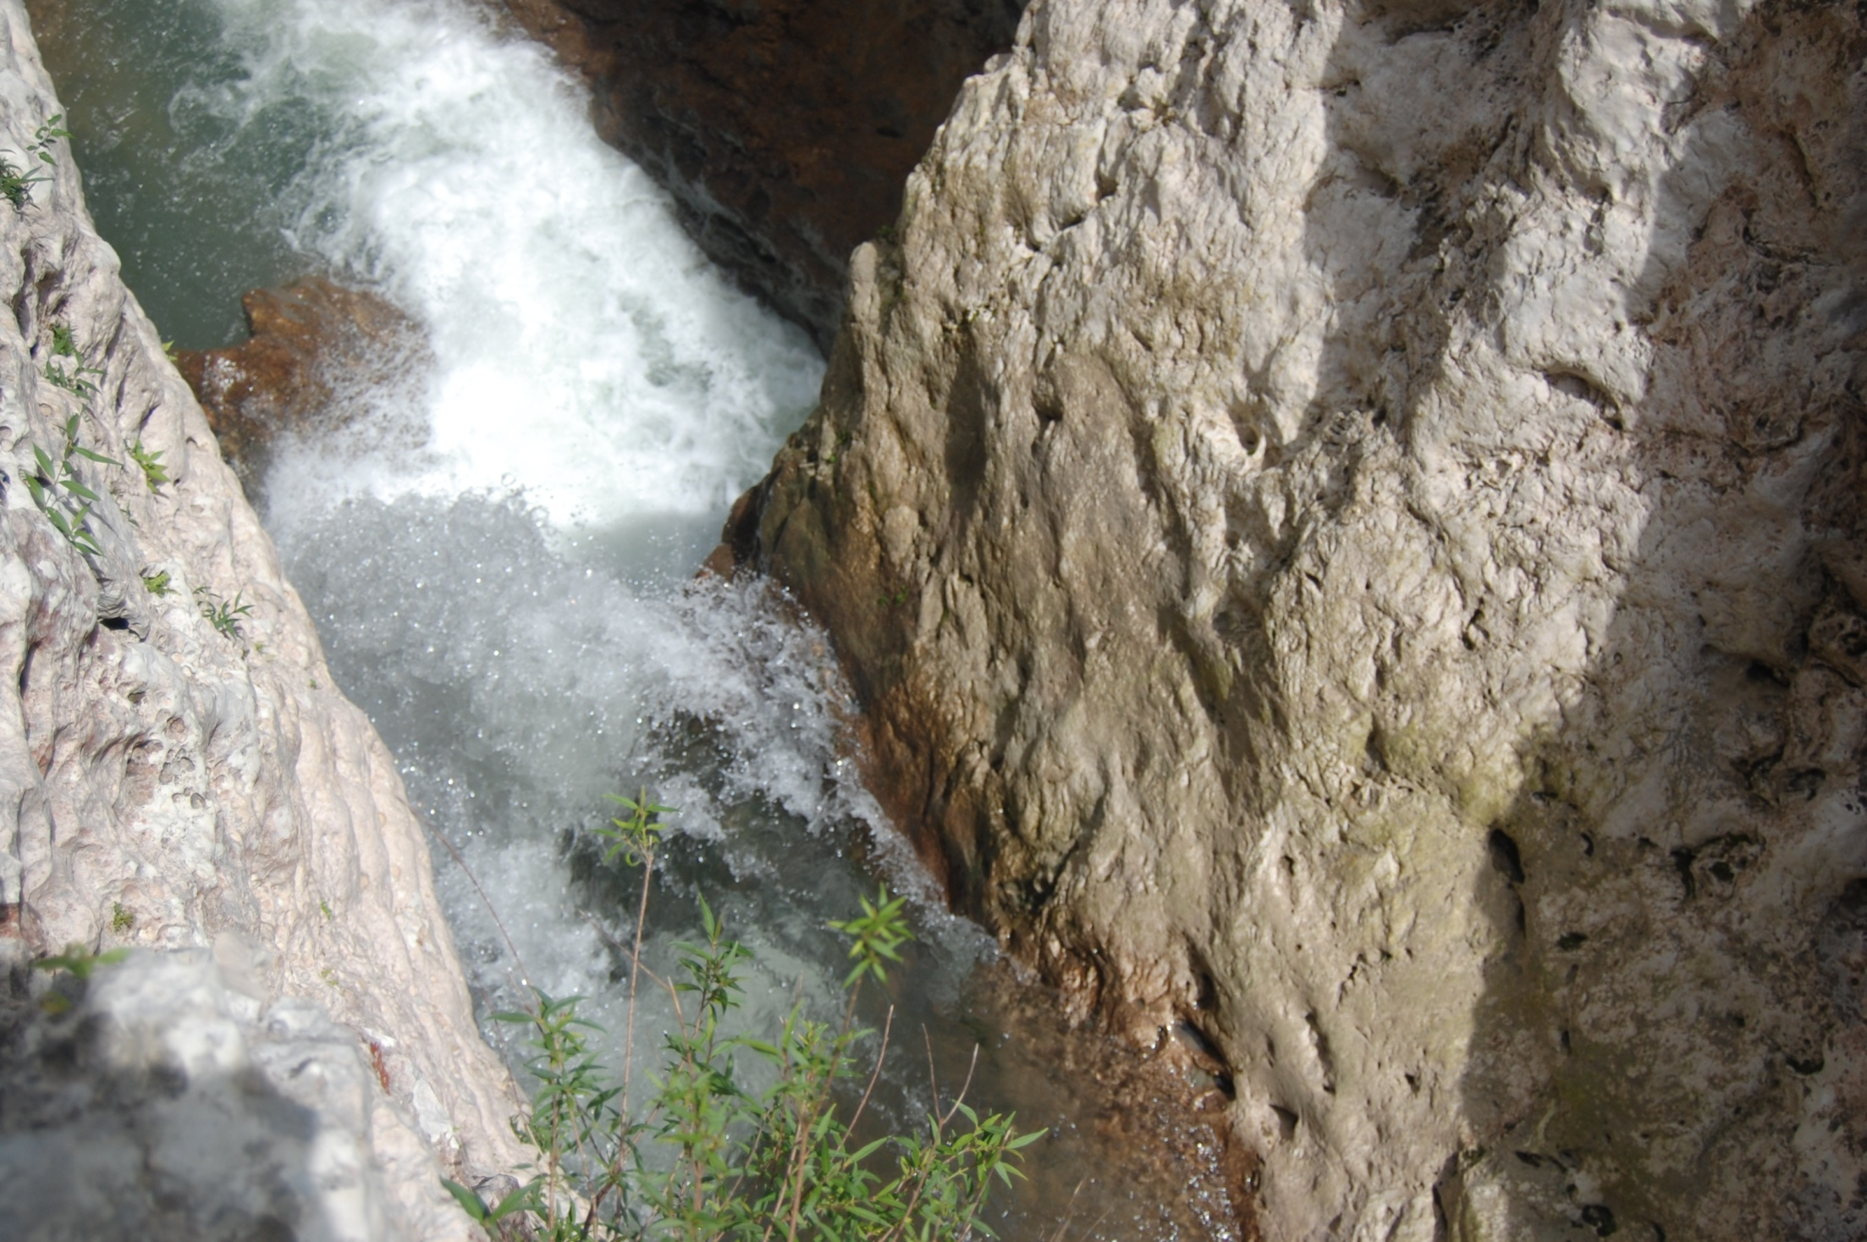
Glace River: Hydro Power

Slide 11
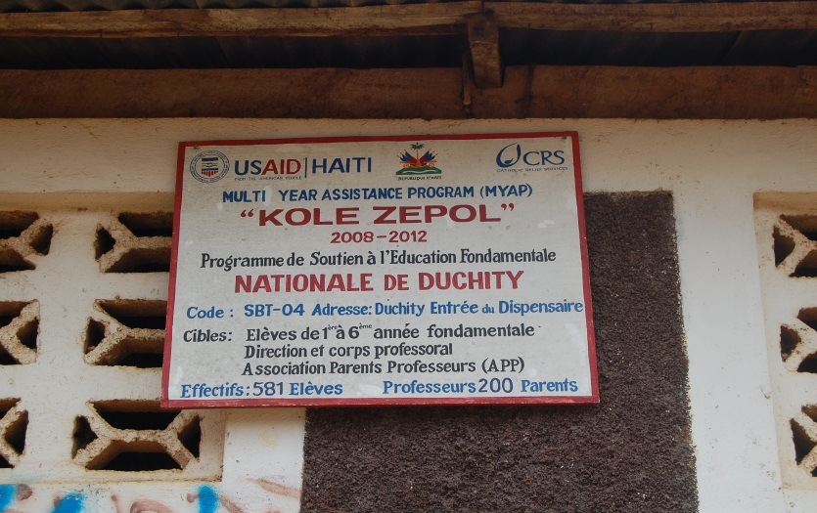
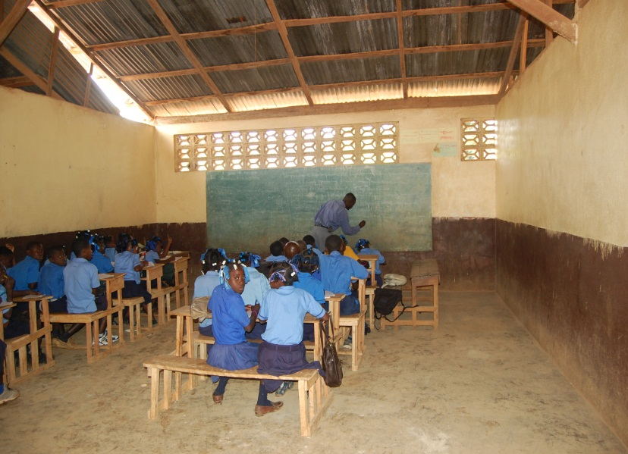
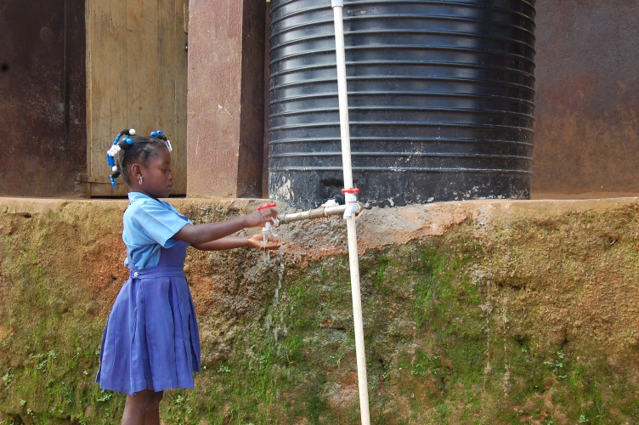
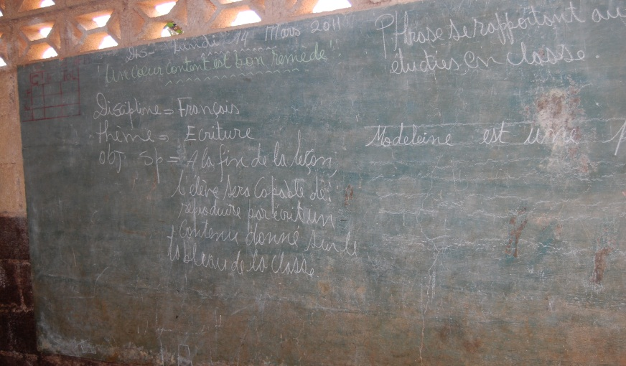
Education in Duchity
Notes:
2011-03-14 c. #261 - #288
2011-03-15 #455

Slide 12
Hardware / Software | Physical Surround-ings | People, Groups, & Roles | Procedures | Laws | Cultural Matters
Diesel Generator Electricity Wiring (inside and outside) Individual Generators | Mountains (stripped and unstripped of vegetation) School: (natural lighting, benches, and blackboards) | Orphanage YouthHaiti Global Initiatives (Rotary Club, UNICEF, etc.) NSF UPRM (land grant university) | Measuring water flow Using/Repairing generator Measuring water fall Making Charcoal (inspecting new school) | Eng Codes (Parish will not fund rebuilding school in Pleasance) Regulating the generation of electricity (public, private, utility) | French Colonialism Language: French and Creole
Computers? Cell Phones? Transportation technology | Earthquake and Tsunami Zones Highways (paved, unpaved) | Universities Primary and Secondary Schools Governments (international context) | Pedagogical Approaches (parochial non-parochial) Student Assessment | Environmental standards and enforcement Land use

